Slide 1
“30 X 30”
What Is It?
How Is It Related To The I.R.S. 1031 Code?
Howard Hutchinson
Executive Director
Coalition of Arizona/New Mexico Counties

Slide 2

What is 30x30?
“…protect 30% of the earth’s lands and waters by 2030, with the ultimate goal of keeping 50% natural. In the United States, only 12% of land is currently protected.“
https://www.nrdc.org/experts/sharon-buccino/red-rocks-role-saving-nature?utm_source=twitter&utm_medium=organic&utm_campaign=Nature

Slide 3
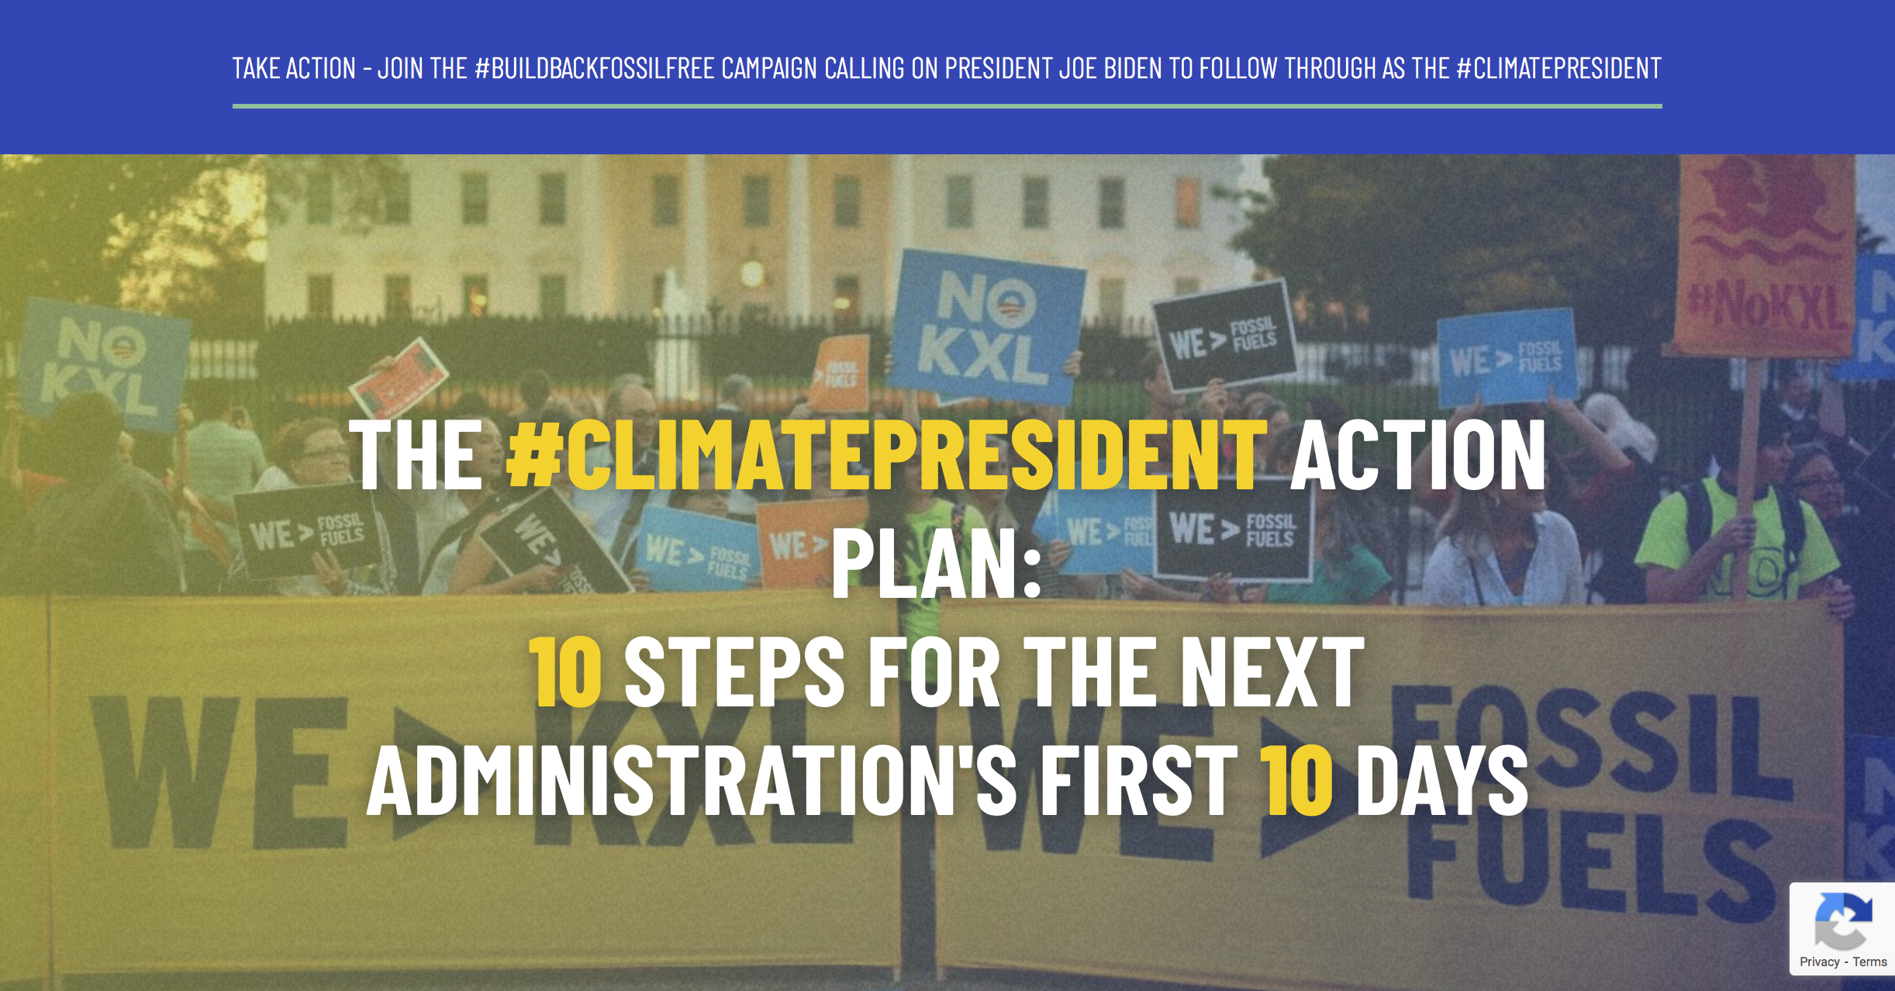
#ClimatePresident Action Plan
Delivered to president elect-Biden December 16, 2020
https://www.climatepresident.org/#list

Slide 4
“TEN ESSENTIAL CLIMATE ACTIONS THE NEXT PRESIDENT CAN TAKE WITHOUT CONGRESS”
“Declare a national climate emergency under the National Emergencies Act.”
“Keep fossil fuels in the ground.”
“Stop fossil fuel exports and infrastructure approvals.”
“Shift financial flows from fossil fuels to climate solutions.”
“Use the Clean Air Act to set a science-based national pollution cap for greenhouse gas pollutants. Then, use all Clear Air Act programs to drive emissions towards zero economy-wide.”
“Power the electricity sector with 100% clean and renewable energy by 2030 and promote energy democracy.”
“Launch a just transition to protect our communities, workers, and economy.”
“Advance Climate Justice: Direct federal agencies to assess and mitigate environmental harms to disproportionately impacted Indigenous Peoples, People and Communities of Color, and low-wealth communities.”
“Make polluters pay: Investigate and prosecute fossil fuel polluters for the damages they have caused. Commit to veto all legislation that grants legal immunity for polluters, undermines existing environmental laws, or advances false solutions.”
“Rejoin the Paris Agreement and lead with science-based commitments that ensure that the United States, as a the world’s largest cumulative historical emitter, contributes its fari share and advances climate justice.”
Delivered to president-elect Biden December 16, 2020
https://www.climatepresident.org/#list

Slide 5
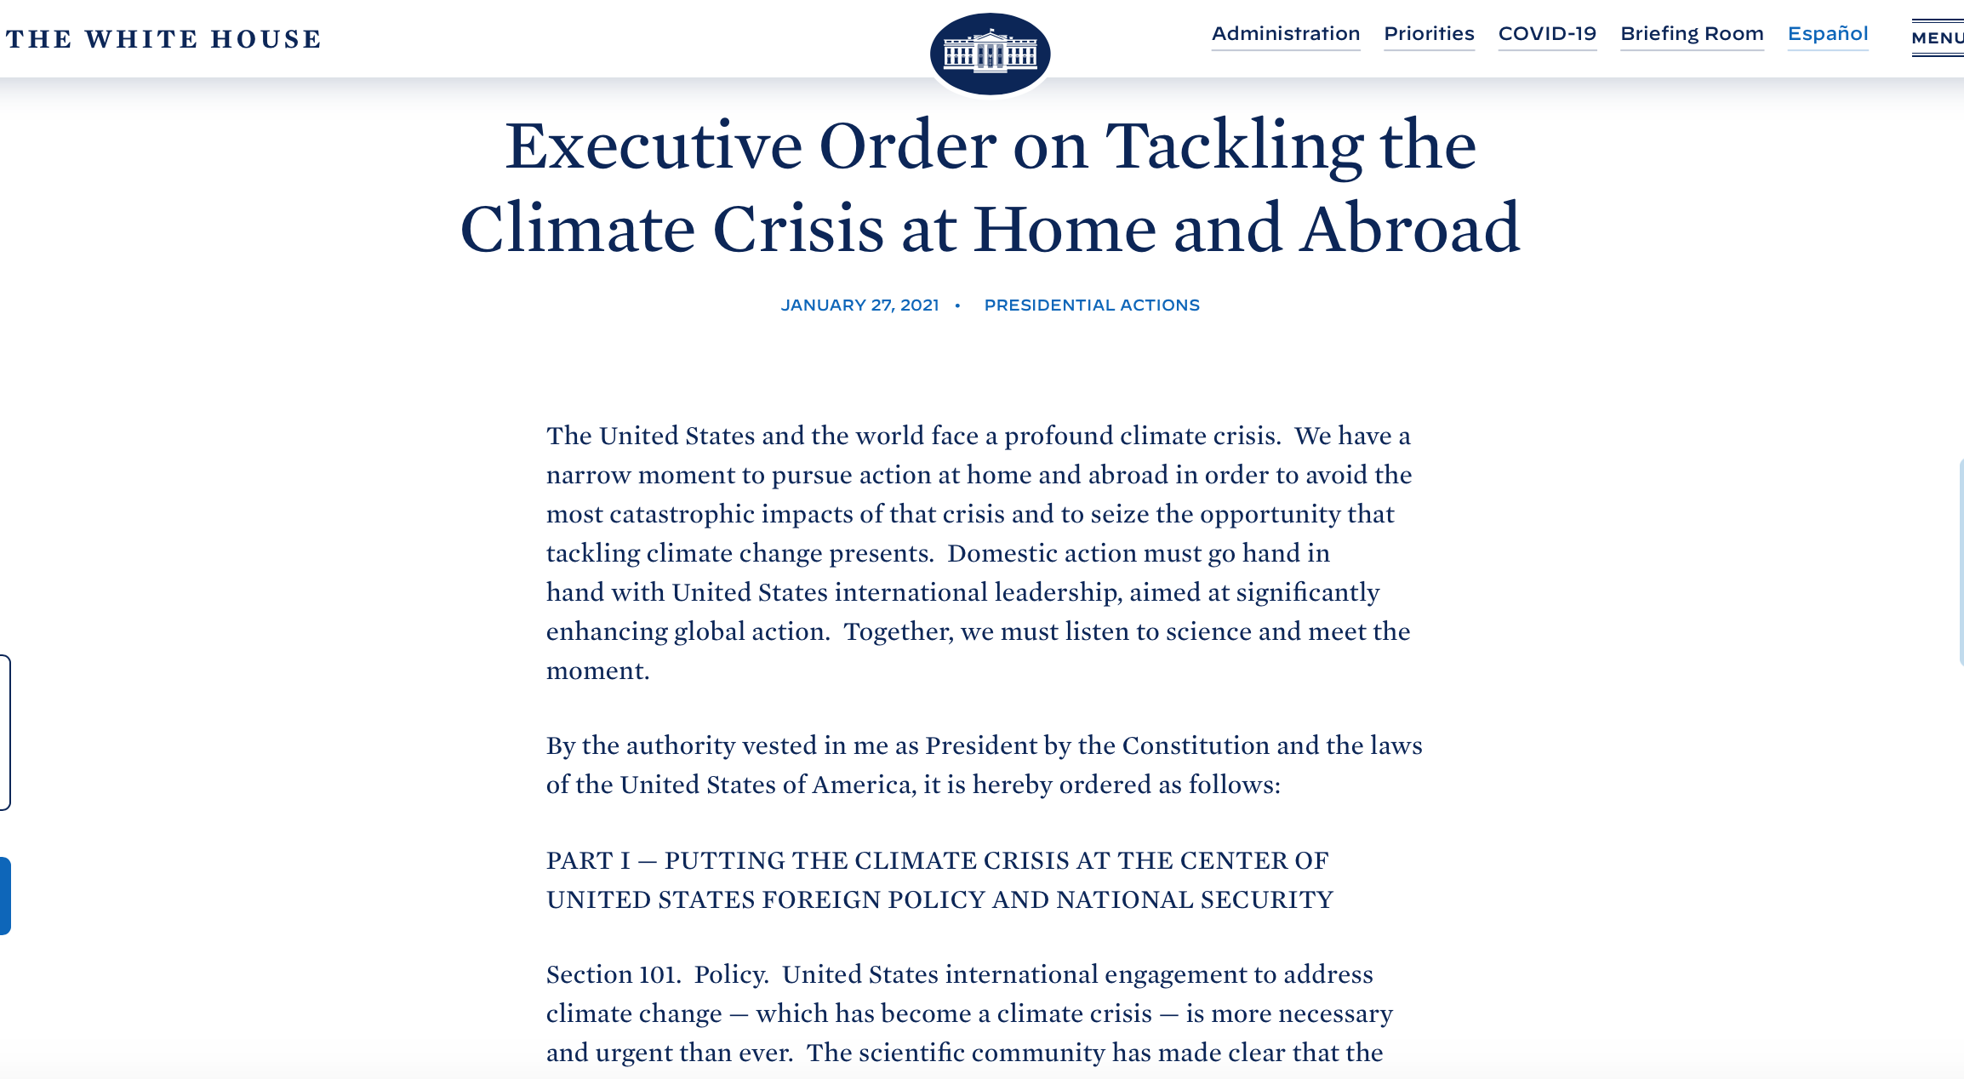
Executive Order 14008
January 27, 2021
“Sec. 102. …promote ending international financing of carbon-intensive fossil fuel-based energy while simultaneously advancing sustainable development and a green recovery…”
https://www.federalregister.gov/documents/2021/02/01/2021-02177/tackling-the-climate-crisis-at-home-and-abroad

Slide 6
Executive Order 14008
January 27, 2021
“Sec. 201. Policy. … we face a climate crisis that threatens our people and communities, public health and economy, and, starkly, our ability to live on planet Earth. Despite the peril that is already evident, there is promise in the solutions — opportunities to create well-paying union jobs to build a modern and sustainable infrastructure, deliver an equitable, clean energy future, and put the United States on a path to achieve net-zero emissions, economy-wide, by no later than 2050.”

Slide 7
Executive Order 14008
January 27, 2021
“Sec. 202. White House Office of Domestic Climate Policy. … All agencies shall cooperate with the Climate Policy Office…to facilitate the organization and deployment of a Government-wide approach to combat the climate crisis. … deliver environmental justice; and spur well-paying union jobs and economic growth. …engage on these matters with State, local, Tribal, and territorial governments; workers and communities; and leaders across the various sectors of our economy … prioritize action on climate change in their policy-making and budget processes, in their contracting and procurement, and in their engagement with State, local, Tribal, and territorial governments; workers and communities; and leaders across all the sectors of our economy.”

Slide 8
Executive Order 14008
January 27, 2021
“Sec. 216. Conserving Our Nation’s Lands and Waters. The Secretary of the Interior … shall submit a report to the Task Force within 90 days of the date of this order recommending steps that the United States should take, working with State, local, Tribal, and territorial governments …to achieve the goal of conserving at least 30 percent of our lands and waters by 2030.”

Slide 9
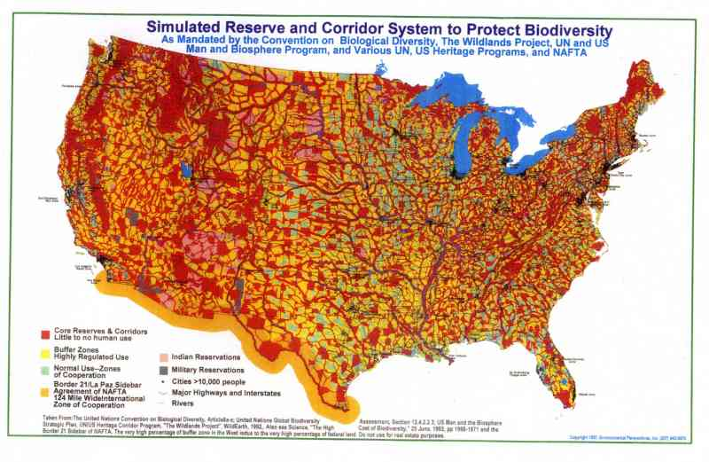

Slide 10
Questions

